Slide 1
EXCEL ASSESMENT
BATHRI D 4352
LVADSUSR144

Slide 2
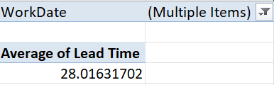
TASK 1 Avg lead time between REQ date and WOK Date
Method: Since we need to calculate avg lead time I am filtering rows which has blank values in WOK Date. Now using pivot table I figured the avg lead time
Inference:
It takes 28 days to finish a work on average.

Slide 3
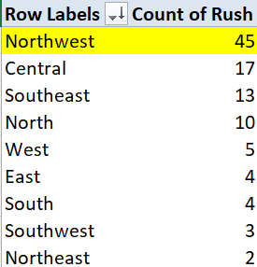
TASK 2 Which district has the highest Rush Jobs
Method: We can use pivot tables and enter the district In row label and rush in values which produces count of rush
Inference: Northwest district has the highest rush jobs

Slide 4
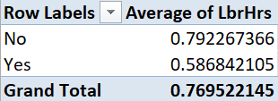
TASK 3 how does the avg lbrhr differ between rush and non-rush job
Method: insert a new column to make blank cells in rush column as “No” with
=IFERROR(IF(E2,"Yes","No"),"Yes") Formula
Now use pivot table to figure out their avg lbrhr and then find the difference
Inference: 0.205425 is the difference in avg lbrhr between rush and non-rush jobs.

Slide 5
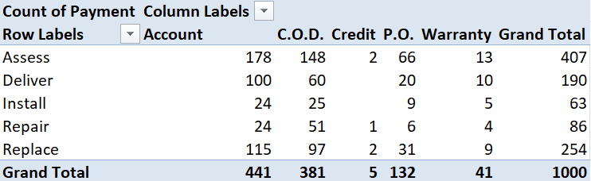
TASK 4 Distribution of payment types(payment) across different services.
Method: Use pivot table, Drag the service in the row label, payment in the value label as count of payment, and payment in column label.
Inference: We can infer that account payment is the most used payment method and Assess service get most count of payments

Slide 6
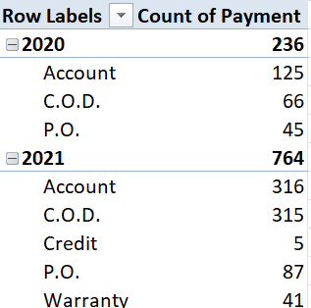
TASK 5 Trends in distribution of payment type over time
Method:
Use pivot table to get year wise distribution of payment type and count of each payment type , now plot a line graph picturing the trends in payment method over time.
Inference:
We can see that account payment method shot up in usage in the year 2021 and new modes of payment like credit and warranty are seen in 2021.

Slide 7
TASK 6 relation between techs required and parts cost
Method:
Find correlation between the column tech and partsfee using =CORREL(WOs!J:J,WOs!T:T) , we get a value of 0.195136736 which means low correlation.
Inference:
Plot a scatter plot to see the relation between the two . We can see that cost tends to be almost same even though the techs required increses

Slide 8
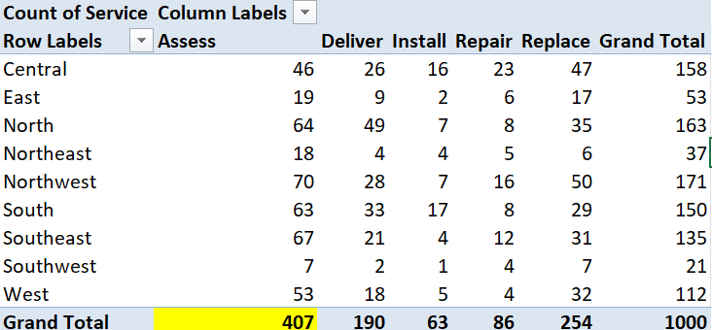
TASK 7 What is the most common type of service requested in each district
Method: Use pivot table to find the distribution of services among different districts .
Inference: Assess is the most common service requested in each district followed by Replace and then Delivery.

Slide 9
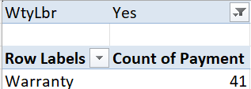
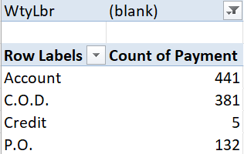
TASK 8 Is there any difference in distribution of payment type for labours who have warranty vs those who don’t have.
Method: Use pivot table , drag the payment to the row label and count of payment in the values, now use the WtyLbr in filters to get distribution of payment type for labours who have warranty and for those who don’t have.
Inference:
Labours who have warranty only use the warranty payment type and no other payment methods, whereas for those who don’t have they use other methods but mostly sticks with Account and C.O.D payment Predominently.

Slide 10
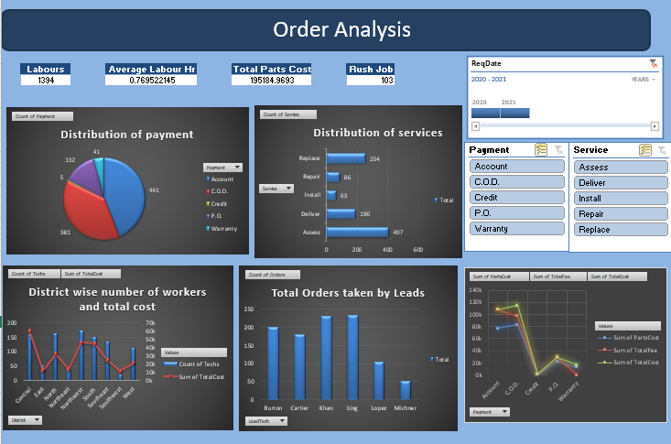
TASK 9 Dashboard

